Slide 1
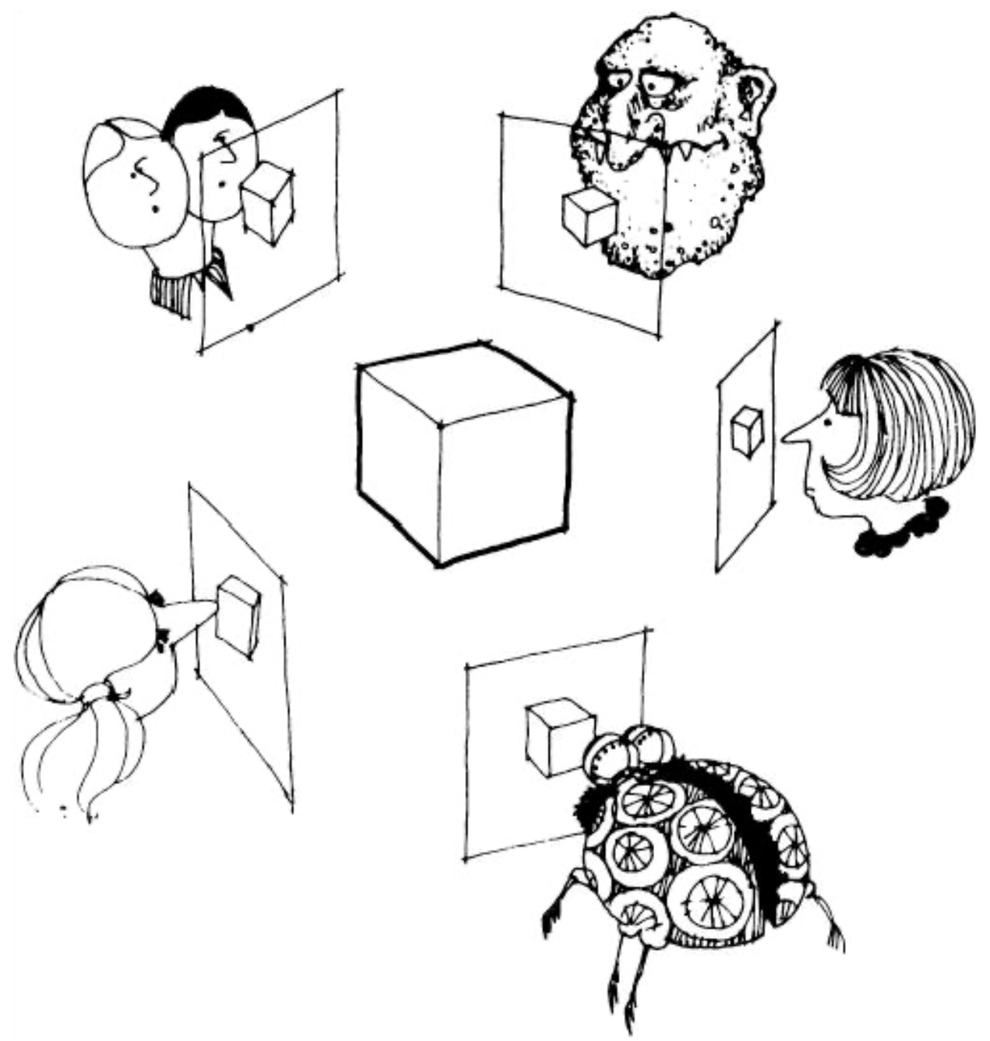
PatchMatch in Multi-View Stereo
Yiming Xie
2020.6.21
Many slides adapted from E. Dunn, S. Shen, Y. Furukawa, M. Pollefeys, and others

Slide 2
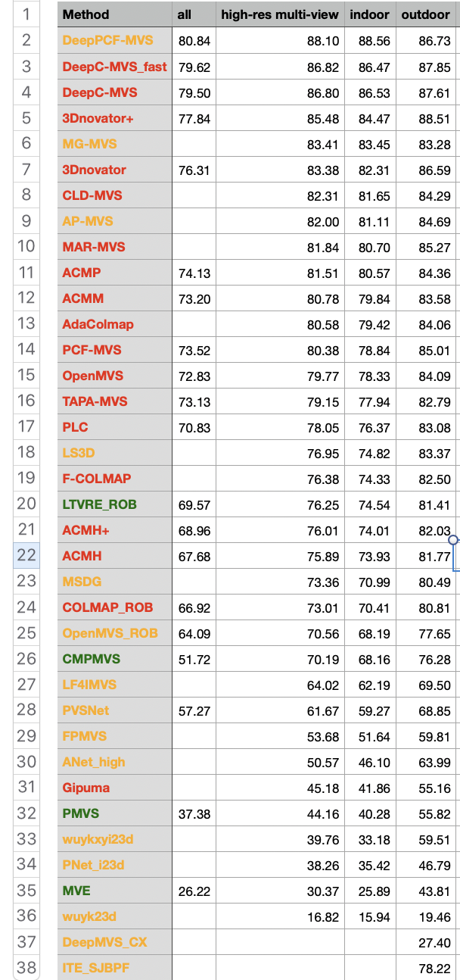
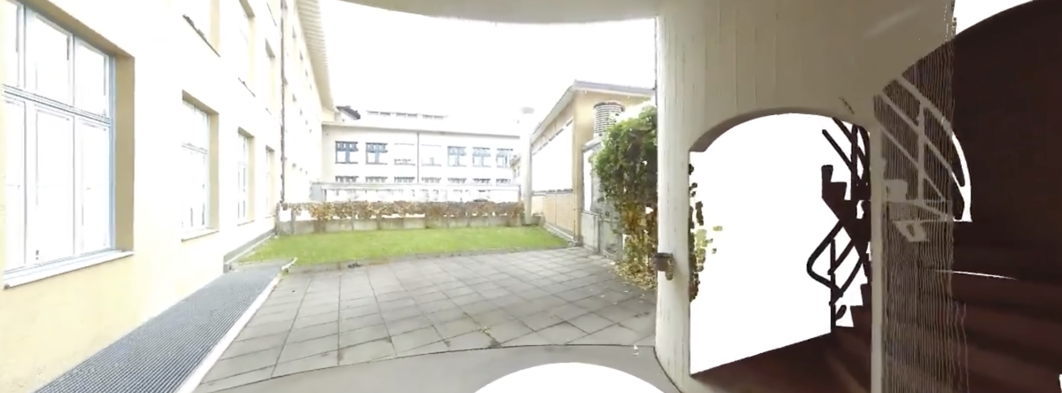
ETH 3D Benchmark(High Res.)
PatchMatch
Unknown
Others
2020.6.20
Notes:
6048 × 4032

Slide 3
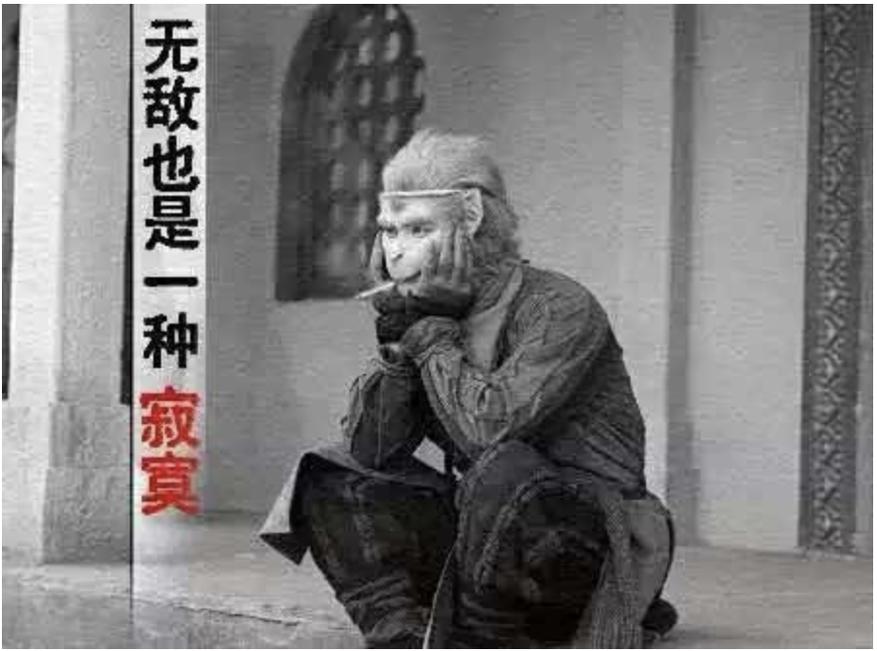
ETH 3D Benchmark(High Res.)
PatchMatch
Unknown
Others
2020.6.20

Slide 4
Topics
Introduction
PatchMatch
PatchMatch Stereo
View Selection

Slide 5
Topics
Introduction
Related Work
Depth-map Merging Based Approaches
PatchMatch Method
Plane Sweeping
Volumetric Based Approaches
Feature Point Growing Based Approaches
Multi-view Stereo and Structure Priors
Limitations and Future Directions
Notes:
There are many factors that differentiate MVS algorithms, such as the photo-consistency function, scene representation, visibility computation, and initialization requirements. Therefore, it is not an easy task to come up with a single classification. In this article we use the output scene representation as an axis of taxonomy, because it often determines the range of possible applications.

Slide 6
Introduction

Slide 7
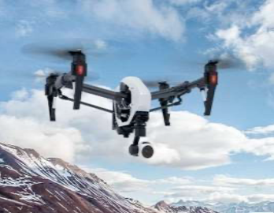
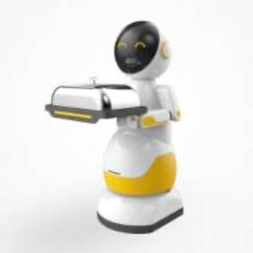
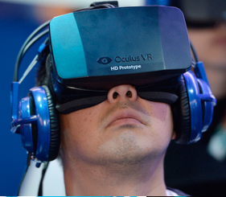
Why Does it Matter?
UAV
Robotics
Augmented Reality
Goal: Sensing 3D Geometry
Notes:
3D mapping and navigation to online shopping, 3D printing, computational photography, computer video games, or cultural heritage archival.

Slide 8
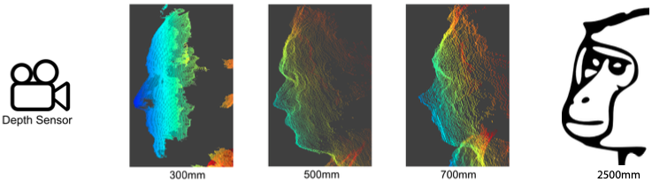
Why Does it Matter?
UAV
Robotics
Augmented Reality
Goal: Sensing 3D Geometry
Notes:
3D mapping and navigation to online shopping, 3D printing, computational photography, computer video games, or cultural heritage archival.

Slide 9
Why Does it Matter?
UAV
Robotics
Augmented Reality
Among all, image-based methods provide a fast way of capturing accurate 3D content at a fraction of the cost of other approaches.
Goal: Sensing 3D Geometry
Notes:
Among all, passive image-based methods, the subject of this tutorial, provide a fast way of capturing accurate 3D content at a fraction of the cost of other approaches.

Slide 10
What is MVS
The goal of image-based 3D reconstruction:
given a set of photographs of an object or a scene, estimate the most likely 3D shape that explains those photographs,
under the assumptions of known materials, viewpoints, and lighting conditions.
Credit: Y. Furukawa
Notes:
The definition highlights the difficulty of the task, namely the assumption that materials, viewpoints, and lighting are known.

Slide 11
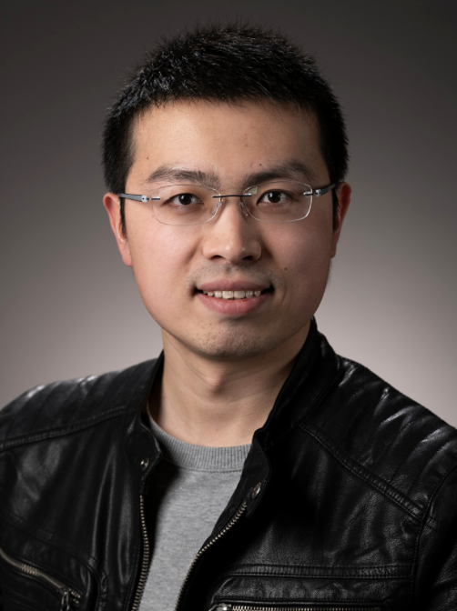
What is MVS
The goal of image-based 3D reconstruction:
given a set of photographs of an object or a scene, estimate the most likely 3D shape that explains those photographs,
under the assumptions of known materials, viewpoints, and lighting conditions.
GAMES 101:
Credit: Y. Furukawa
$Geometry+viewpoints+materials\left(BRDF\right)+lighting \underset{→}{\text{rendering} \text{equation}}$ image
Notes:
The definition highlights the difficulty of the task, namely the assumption that materials, viewpoints, and lighting are known.

Slide 12
What is MVS
The goal of image-based 3D reconstruction:
given a set of photographs of an object or a scene, estimate the most likely 3D shape that explains those photographs,
under the assumptions of known materials, viewpoints, and lighting conditions.
GAMES 101:
If these are not known, the problem is generally ill-posed!
Credit: Y. Furukawa
$Geometry+viewpoints+materials\left(BRDF\right)+lighting \underset{→}{\text{rendering} \text{equation}}$ image
Notes:
The definition highlights the difficulty of the task, namely the assumption that materials, viewpoints, and lighting are known.

Slide 13
What is MVS
Multi-view stereo (MVS): use stereo correspondence as their main cue and use more than two images to extract geometry from photographs.
Notes:
assume photo-consistency for opaque objects and cannot handle complex light paths of transparent shapes.

Slide 14
What is MVS
Multi-view stereo (MVS): use stereo correspondence as their main cue and use more than two images to extract geometry from photographs.
Lambertian textured surfaces.
Known camera parameters.
Notes:
assume photo-consistency for opaque objects and cannot handle complex light paths of transparent shapes.

Slide 15
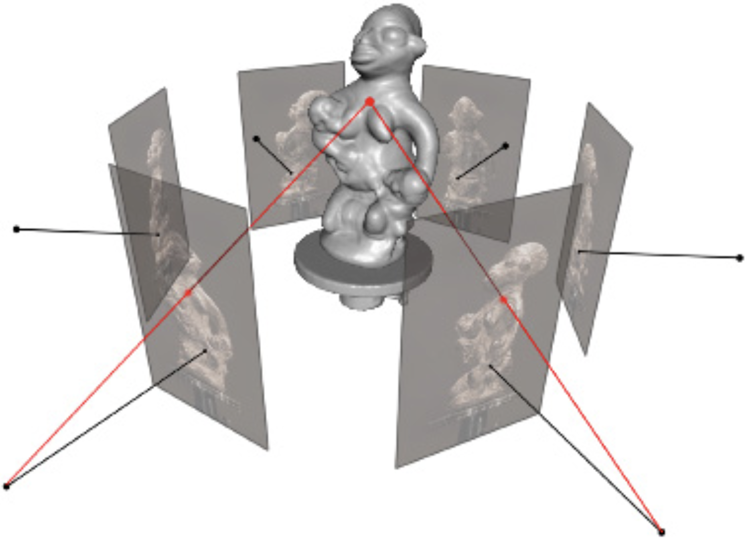
What is MVS
Multi-view stereo (MVS): use stereo correspondence as their main cue and use more than two images to extract geometry from photographs.
Lambertian textured surfaces.
Known camera parameters.
Input: multiple images with calibrated cameras
Output: dense 3d representation
Credit: Y. Furukawa

Slide 16
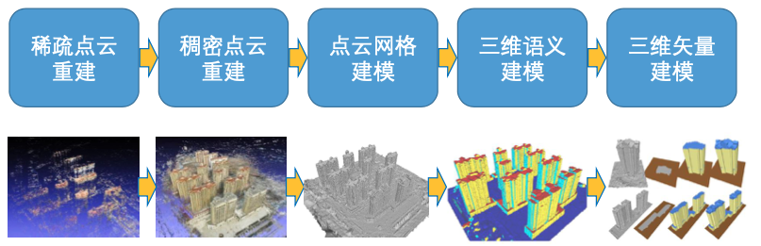
What is MVS
Multi-view stereo (MVS): use stereo correspondence as their main cue and use more than two images to extract geometry from photographs.
Rigid Lambertian textured surfaces.
Known camera parameters.
Credit: Shuhan Shen

Slide 17
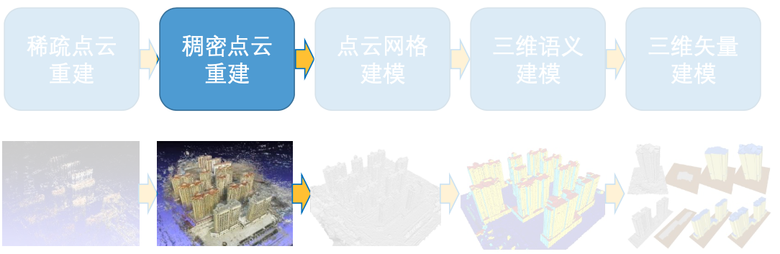
What is MVS
Multi-view stereo (MVS): use stereo correspondence as their main cue and use more than two images to extract geometry from photographs.
Rigid Lambertian textured surfaces.
Known camera parameters.
Credit: Shuhan Shen
Notes:
the Lambertian BRDF is ρ/π，ρ is the measure of diffuse reflection.

Slide 18
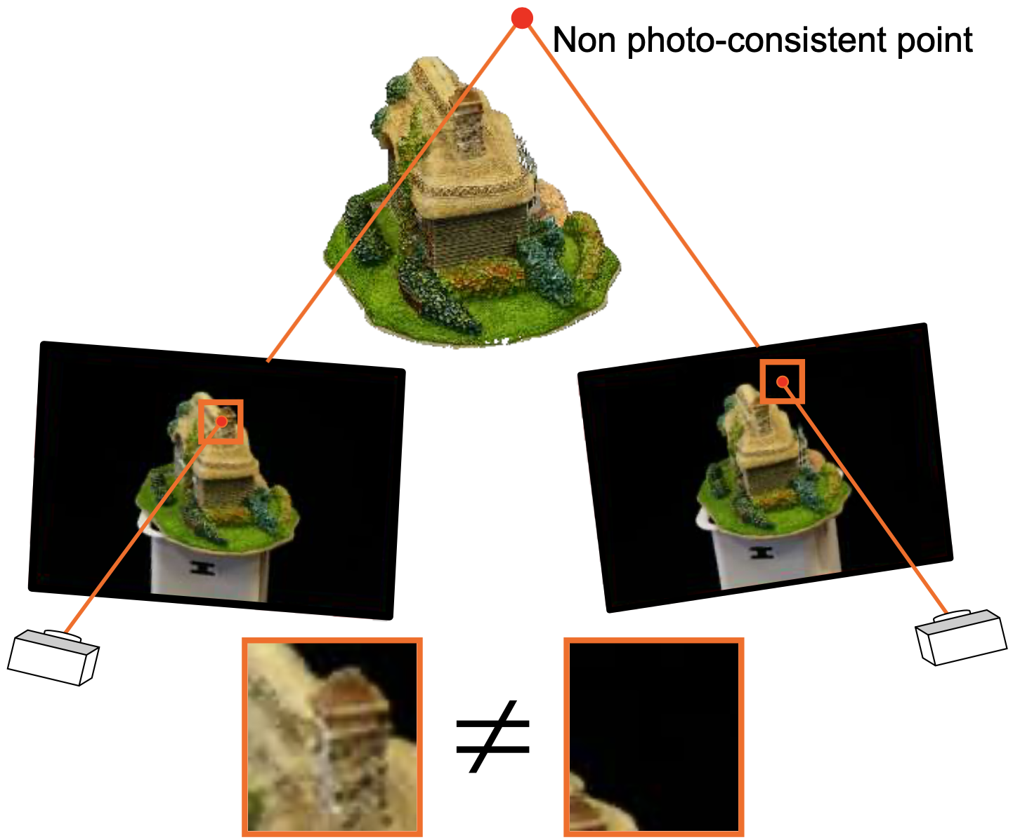
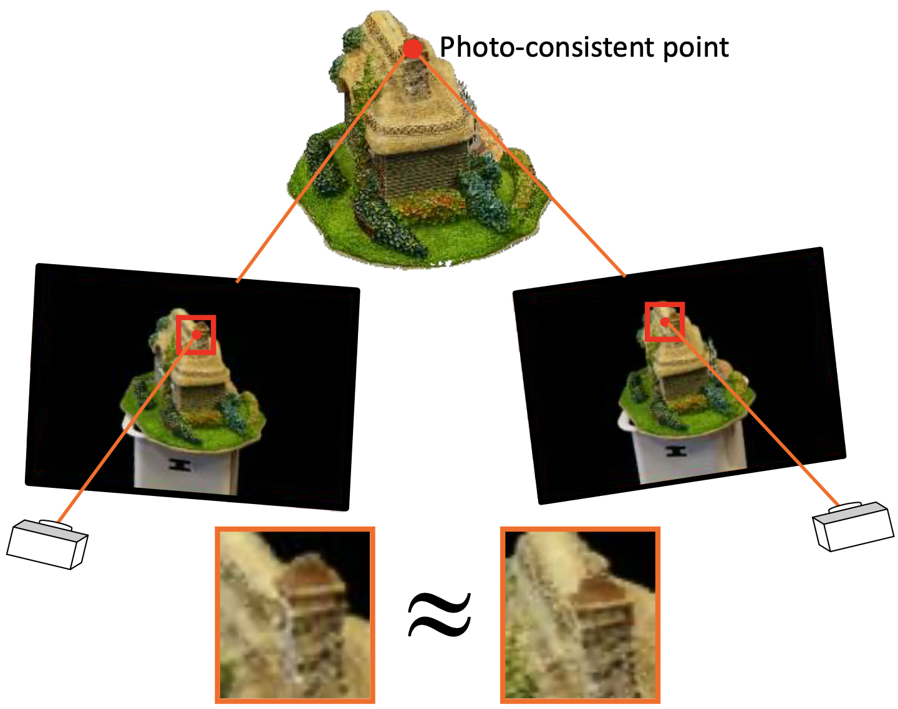
Multi-view stereo: Basic idea
Look for points in space that have photo-consistency.
Credit: Shuhan Shen
Notes:
solving for the 3D geometry of the scene is exactly equivalent to solving the correspondence problem across the input images.
Multi-view photo-consistency measures the agreement or consistency between a set of input photographs and all the ingredients that take part in their image formation: illumination, materials, and 3D geometry of the scene being captured

Slide 19
Multi-view stereo: Basic idea
Look for points in space that have photo-consistency.
Dense correspondence!!
Credit: Shuhan Shen

Slide 20
Summary
Why?
capture accurate 3D geometry, and image-based method is cheap.
What?
use stereo correspondence as their main cue and use more than two images to extract geometry from photographs.
How?
Look for points in space that have photo-consistency.

Slide 21
Depth-map Merging Based Approaches

Slide 22
Depth-map Merging Based Approaches

Slide 23
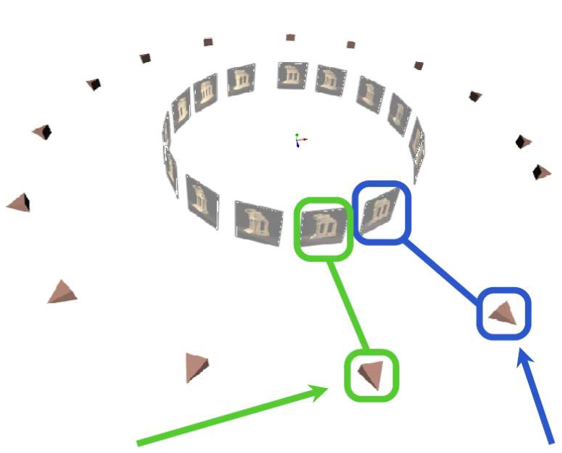
Depth-map Merging Based Approaches
Step 1: Source view selection
reference view
source view
Credit: Shuhan Shen
Notes:
MVS algorithms are designed to deal with images with more varying viewpoints, such as an image set surrounding an object, and also deal with a very large number of images, even in the order of millions.
The multi-view version of stereo originated as a natural improvement to the two-view case. Instead of capturing two photographs from two different viewpoints, multi-view stereo would capture more viewpoints in-between to increase robustness, e.g. to image noise or surface texture.

Slide 24
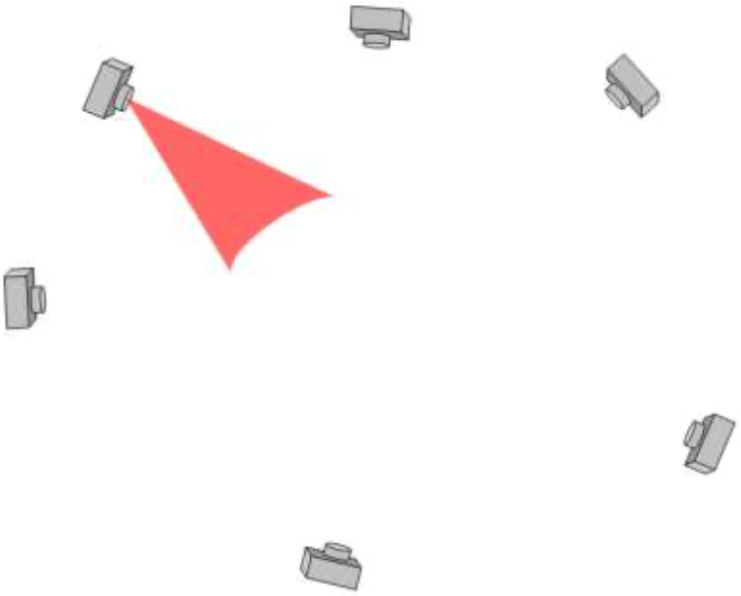
Depth-map Merging Based Approaches
Step 2: Depth-map computation
Credit: Shuhan Shen

Slide 25
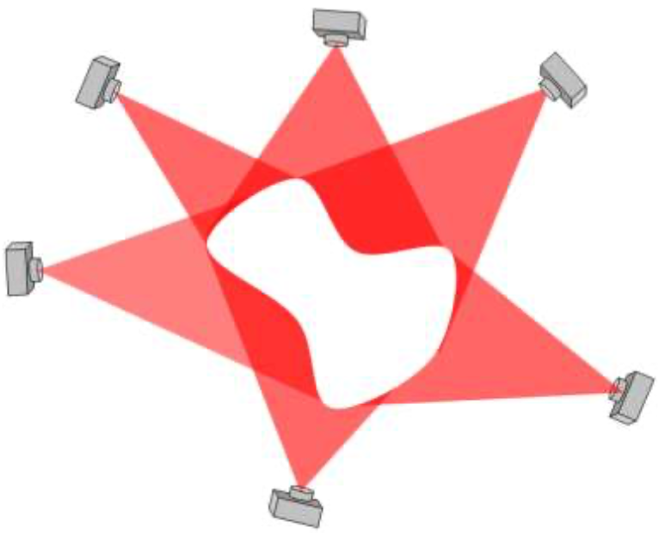
Depth-map Merging Based Approaches
Step 3: Depth-map merging
Credit: Shuhan Shen

Slide 26
Step 1: Source view selection
Step 2: Depth-map computation
Step 3: Depth-map merging
Key steps:
1.How to chose source images
2.How to compute depth map

Slide 27
How to compute depth map

Slide 28
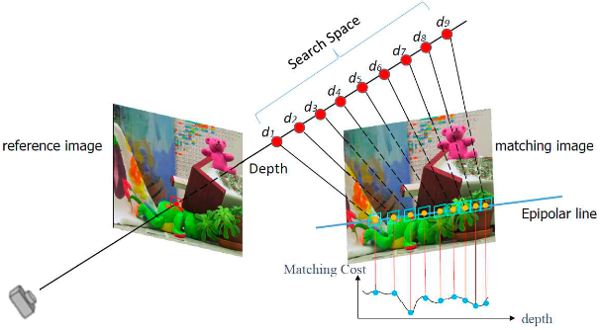
Compute Depth Map: Basic idea
Look for points in space that have photo-consistency.
Credit: E. Dunn
Notes:
A pixel in an image generates a 3D optic-ray that passes through the pixel and the camera center of the image. The corresponding pixel on another image can only lie on the projection of that optic ray into the second image. The different geometric constraints that originate when multiple cameras look at the same 3D scene from different viewpoints are known as epipolar geometry.
As for measures to tell how likely a candidate match is, there is a vast literature on how to build so called photo-consistency measures that estimate the likelihood of two pixels (or groups of pixels) being in correspondence.
More measurements per point can reduce error

Slide 29

Compute Depth Map: Basic idea
Look for points in space that have photo-consistency.
limit on high resolution images
Credit: E. Dunn
Notes:
One drawback of this technique is the large size of the cost volume and subsequently the increased optimization complexity, which depends polynomially on the image resolution limiting their applicability on high resolution images

Slide 30
PatchMatch

Slide 31
PatchMatch
A randomized algorithm for rapidly finding correspondences between image patches
C. Barnes, et. al. “PatchMatch: A randomized correspondence algorithm for structural image editing”. SIGGRAPH 2009
Notes:
key insights: some good patch matches can be found via random sampling, and that natural coherence in the imagery allows us to propagate such matches quickly to surrounding areas.

Slide 32
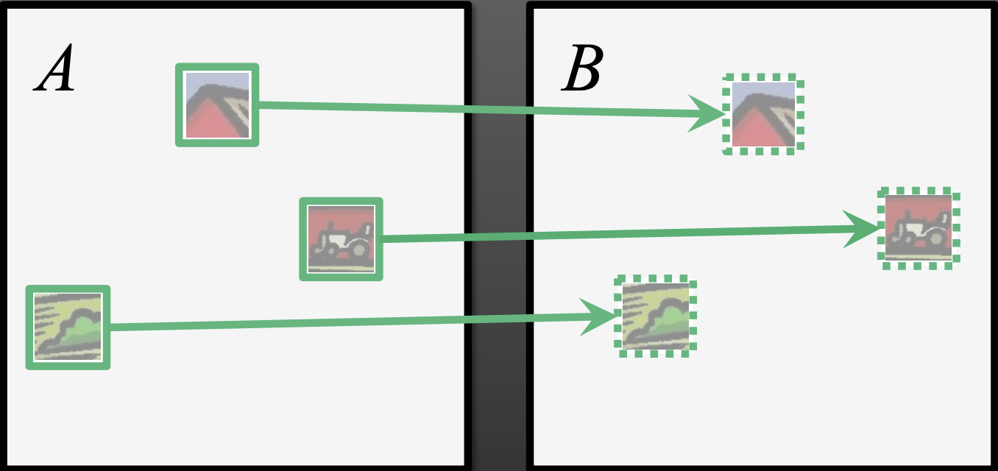
PatchMatch
Problem definition:
Given images A and B, for each overlapping patch in image A, compute the offset to the nearest neighbor patch in image B
C. Barnes, et. al. “PatchMatch: A randomized correspondence algorithm for structural image editing”. SIGGRAPH 2009
Notes:
key insights: some good patch matches can be found via random sampling, and that natural coherence in the imagery allows us to propagate such matches quickly to surrounding areas.

Slide 33
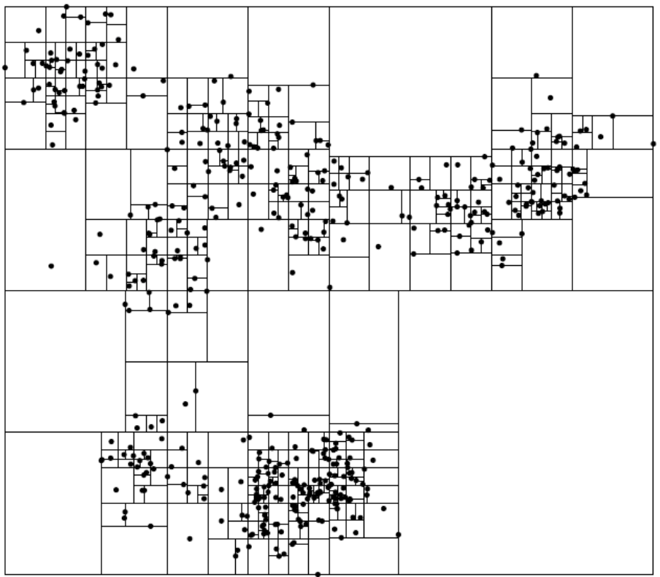
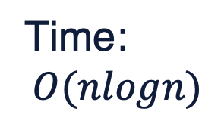
Previous Work
Time:
$$O(nlogn)$$
Kd-tree with PCA
Credit: Hertzmann
Notes:
key insights: some good patch matches can be found via random sampling, and that natural coherence in the imagery allows us to propagate such matches quickly to surrounding areas.

Slide 34
Key observation one
Law of large numbers: a non-trivial fraction of a large field of random offset assignments are likely to be good guesses
C. Barnes, et. al. “PatchMatch: A randomized correspondence algorithm for structural image editing”. SIGGRAPH 2009
Notes:
key insights: some good patch matches can be found via random sampling, and that natural coherence in the imagery allows us to propagate such matches quickly to surrounding areas.

Slide 35
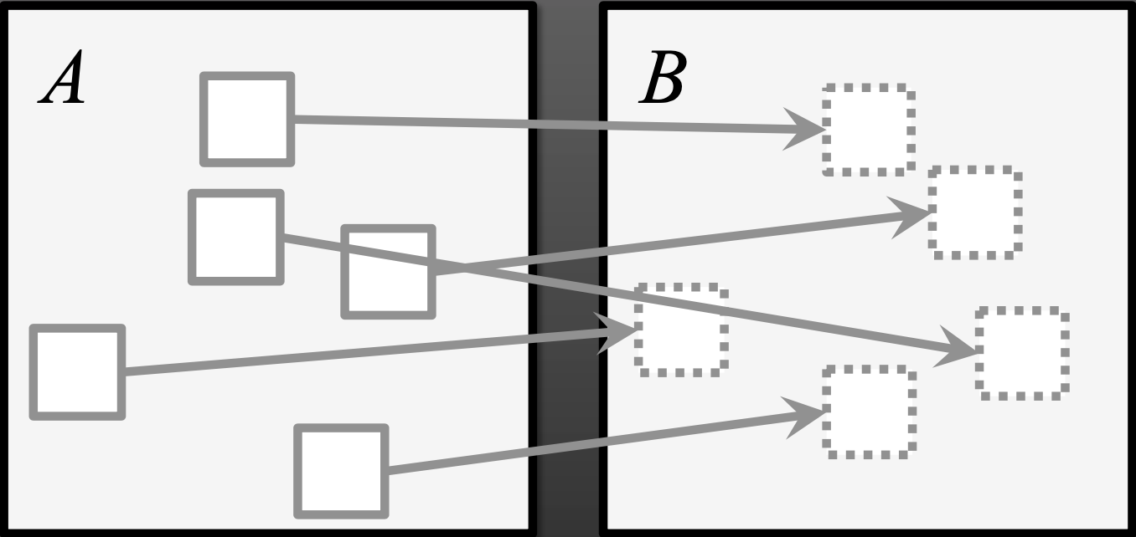
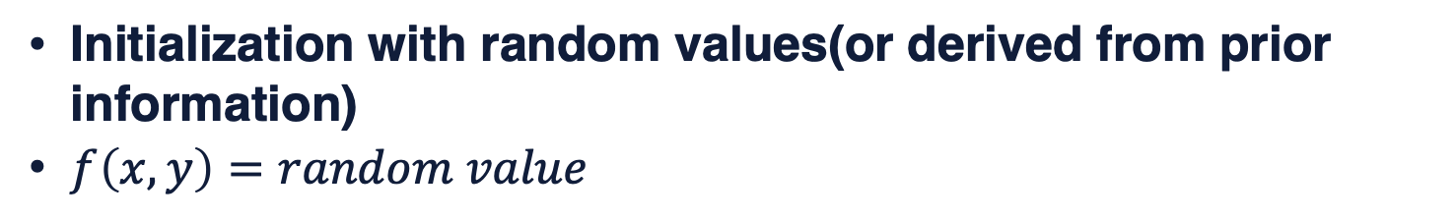
Step 1: Initialization
Initialization with random values(or derived from prior information)
$f\left(x,y\right)=random value$
C. Barnes, et. al. “PatchMatch: A randomized correspondence algorithm for structural image editing”. SIGGRAPH 2009
Notes:
key insights: some good patch matches can be found via random sampling, and that natural coherence in the imagery allows us to propagate such matches quickly to surrounding areas.

Slide 36
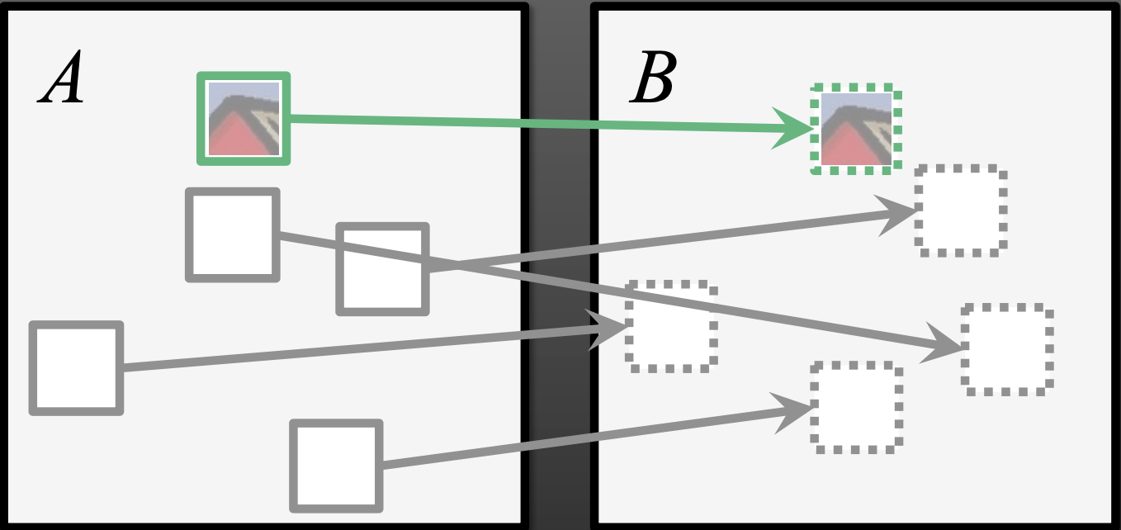
Step 1: Initialization
Initialization with random values(or derived from prior information)
$f\left(x,y\right)=random value$
C. Barnes, et. al. “PatchMatch: A randomized correspondence algorithm for structural image editing”. SIGGRAPH 2009
Notes:
key insights: some good patch matches can be found via random sampling, and that natural coherence in the imagery allows us to propagate such matches quickly to surrounding areas.

Slide 37
Key observation two: spatial coherence
High coherence of nearest neighbors in natural images
Nearest neighbor of patch at (x,y) should be a strong hint for where to find nearest neighbor of patch at (x+1,y)
C. Barnes, et. al. “PatchMatch: A randomized correspondence algorithm for structural image editing”. SIGGRAPH 2009
Notes:
key insights: some good patch matches can be found via random sampling, and that natural coherence in the imagery allows us to propagate such matches quickly to surrounding areas.

Slide 38
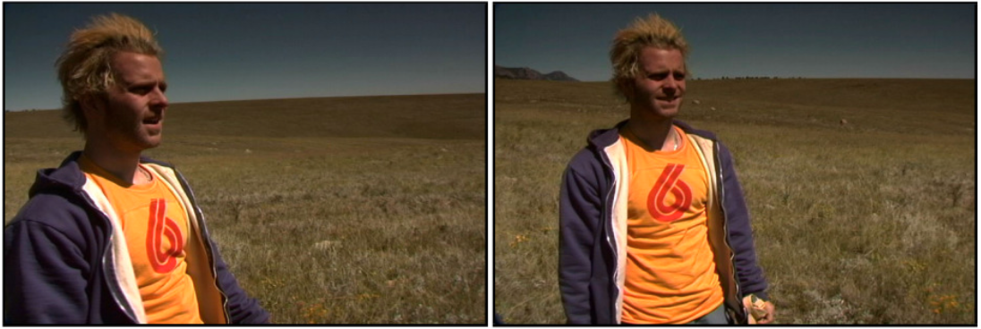
Key observation two: spatial coherence
Credit: C. Barnes
C. Barnes, et. al. “PatchMatch: A randomized correspondence algorithm for structural image editing”. SIGGRAPH 2009

Slide 39
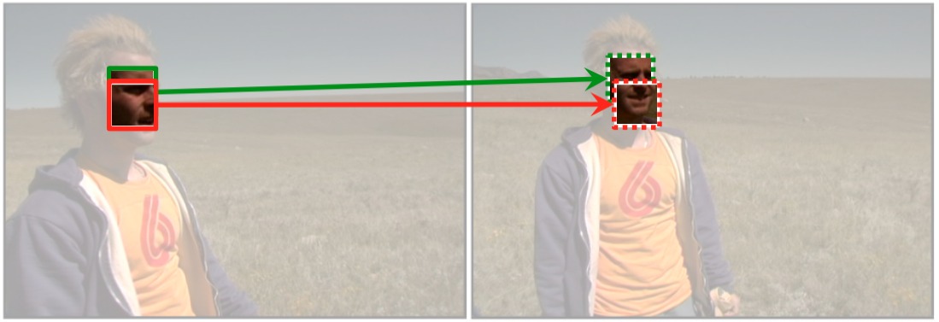
Key observation two: spatial coherence
Credit: C. Barnes
C. Barnes, et. al. “PatchMatch: A randomized correspondence algorithm for structural image editing”. SIGGRAPH 2009

Slide 40
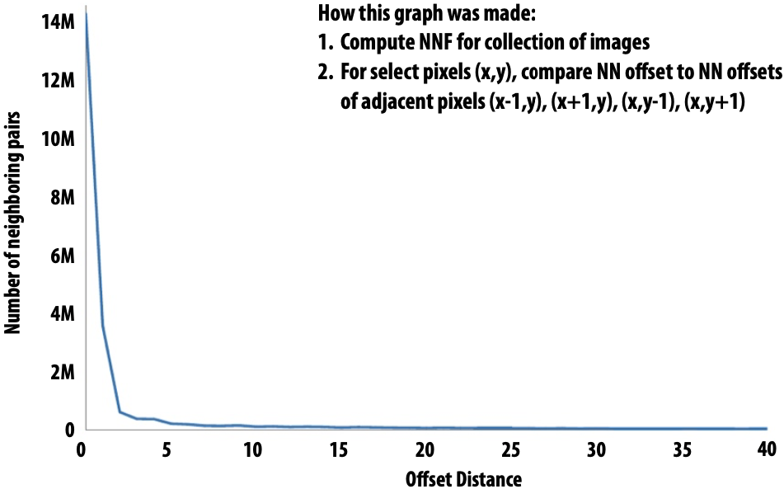
Use Statistics
C. Barnes, et. al. “PatchMatch: A randomized correspondence algorithm for structural image editing”. SIGGRAPH 2009
Notes:
key insights: some good patch matches can be found via random sampling, and that natural coherence in the imagery allows us to propagate such matches quickly to surrounding areas.

Slide 41
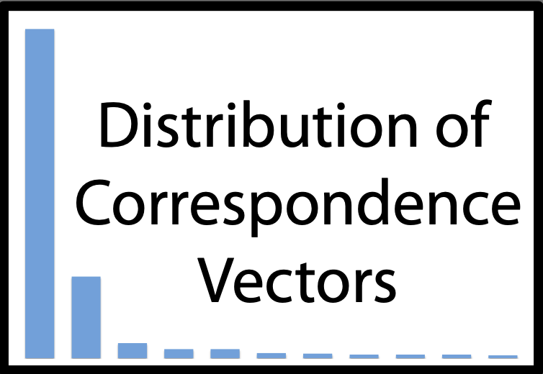
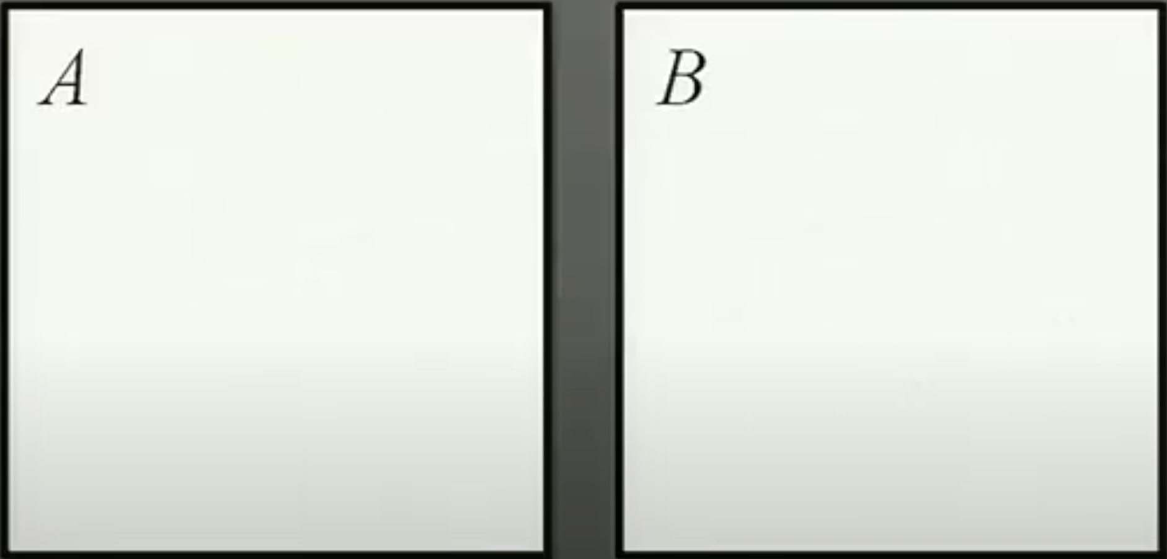
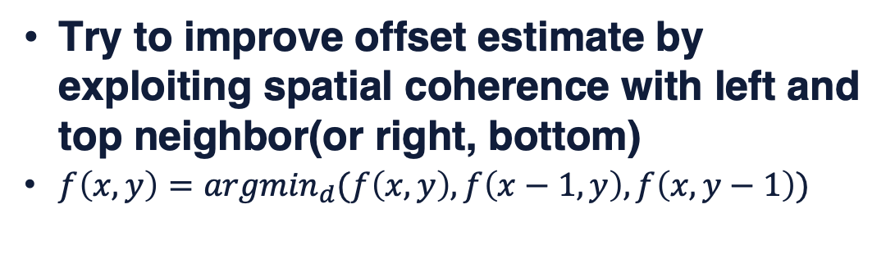
Step 2: Propagation
Try to improve offset estimate by exploiting spatial coherence with left and top neighbor(or right, bottom)
$f\left(x,y\right)={argmin}_{d}(f\left(x,y\right), f\left(x−1,y\right),f\left(x, y−1\right))$
C. Barnes, et. al. “PatchMatch: A randomized correspondence algorithm for structural image editing”. SIGGRAPH 2009
Notes:
key insights: some good patch matches can be found via random sampling, and that natural coherence in the imagery allows us to propagate such matches quickly to surrounding areas.

Slide 42
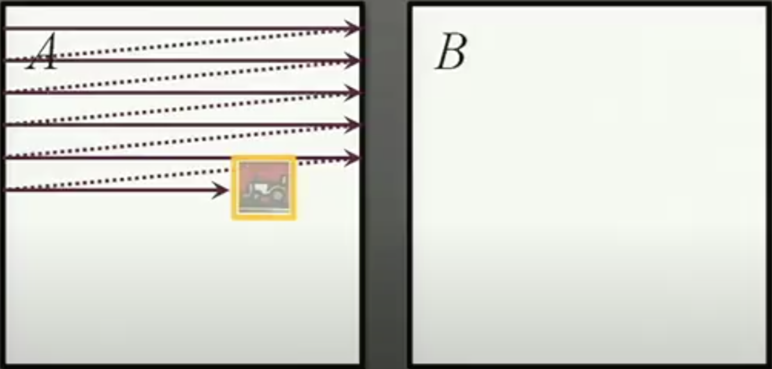
Step 2: Propagation
Try to improve offset estimate by exploiting spatial coherence with left and top neighbor(or right, bottom)
$f\left(x,y\right)={argmin}_{d}(f\left(x,y\right), f\left(x−1,y\right),f\left(x, y−1\right))$
C. Barnes, et. al. “PatchMatch: A randomized correspondence algorithm for structural image editing”. SIGGRAPH 2009
Notes:
key insights: some good patch matches can be found via random sampling, and that natural coherence in the imagery allows us to propagate such matches quickly to surrounding areas.

Slide 43
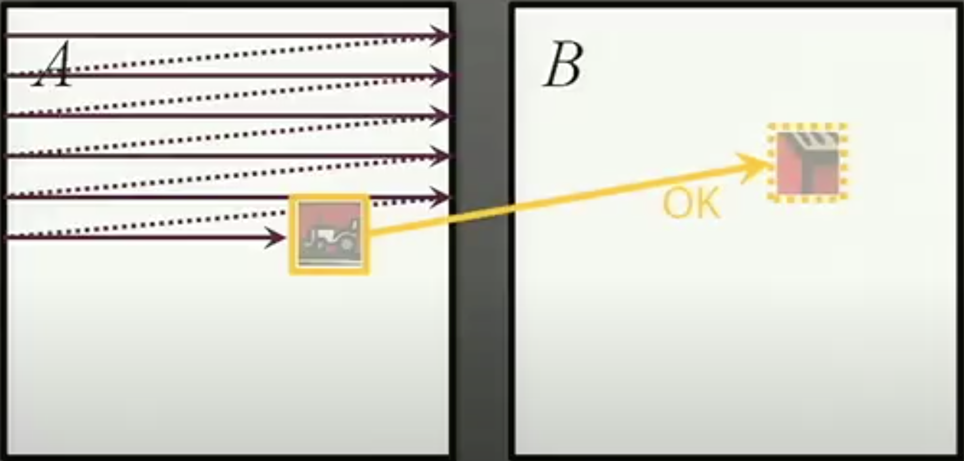
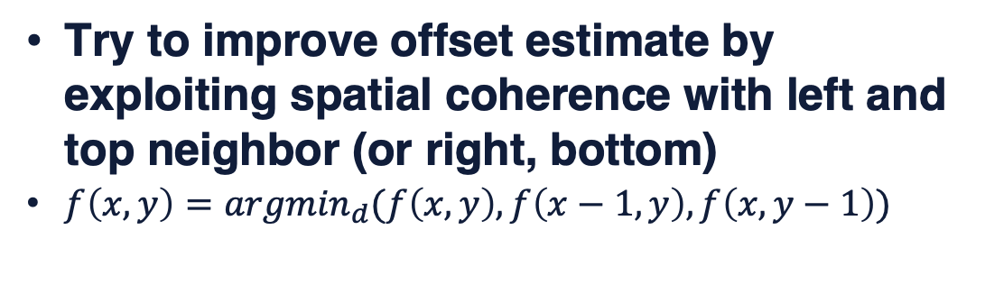
Step 2: Propagation
Try to improve offset estimate by exploiting spatial coherence with left and top neighbor (or right, bottom)
$f\left(x,y\right)={argmin}_{d}(f\left(x,y\right), f\left(x−1,y\right),f\left(x, y−1\right))$
C. Barnes, et. al. “PatchMatch: A randomized correspondence algorithm for structural image editing”. SIGGRAPH 2009
Notes:
key insights: some good patch matches can be found via random sampling, and that natural coherence in the imagery allows us to propagate such matches quickly to surrounding areas.

Slide 44
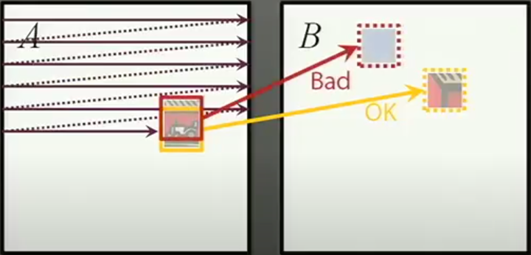
Step 2: Propagation
Try to improve offset estimate by exploiting spatial coherence with left and top neighbor (or right, bottom)
$f\left(x,y\right)={argmin}_{d}(f\left(x,y\right), f\left(x−1,y\right),f\left(x, y−1\right))$
C. Barnes, et. al. “PatchMatch: A randomized correspondence algorithm for structural image editing”. SIGGRAPH 2009
Notes:
key insights: some good patch matches can be found via random sampling, and that natural coherence in the imagery allows us to propagate such matches quickly to surrounding areas.

Slide 45
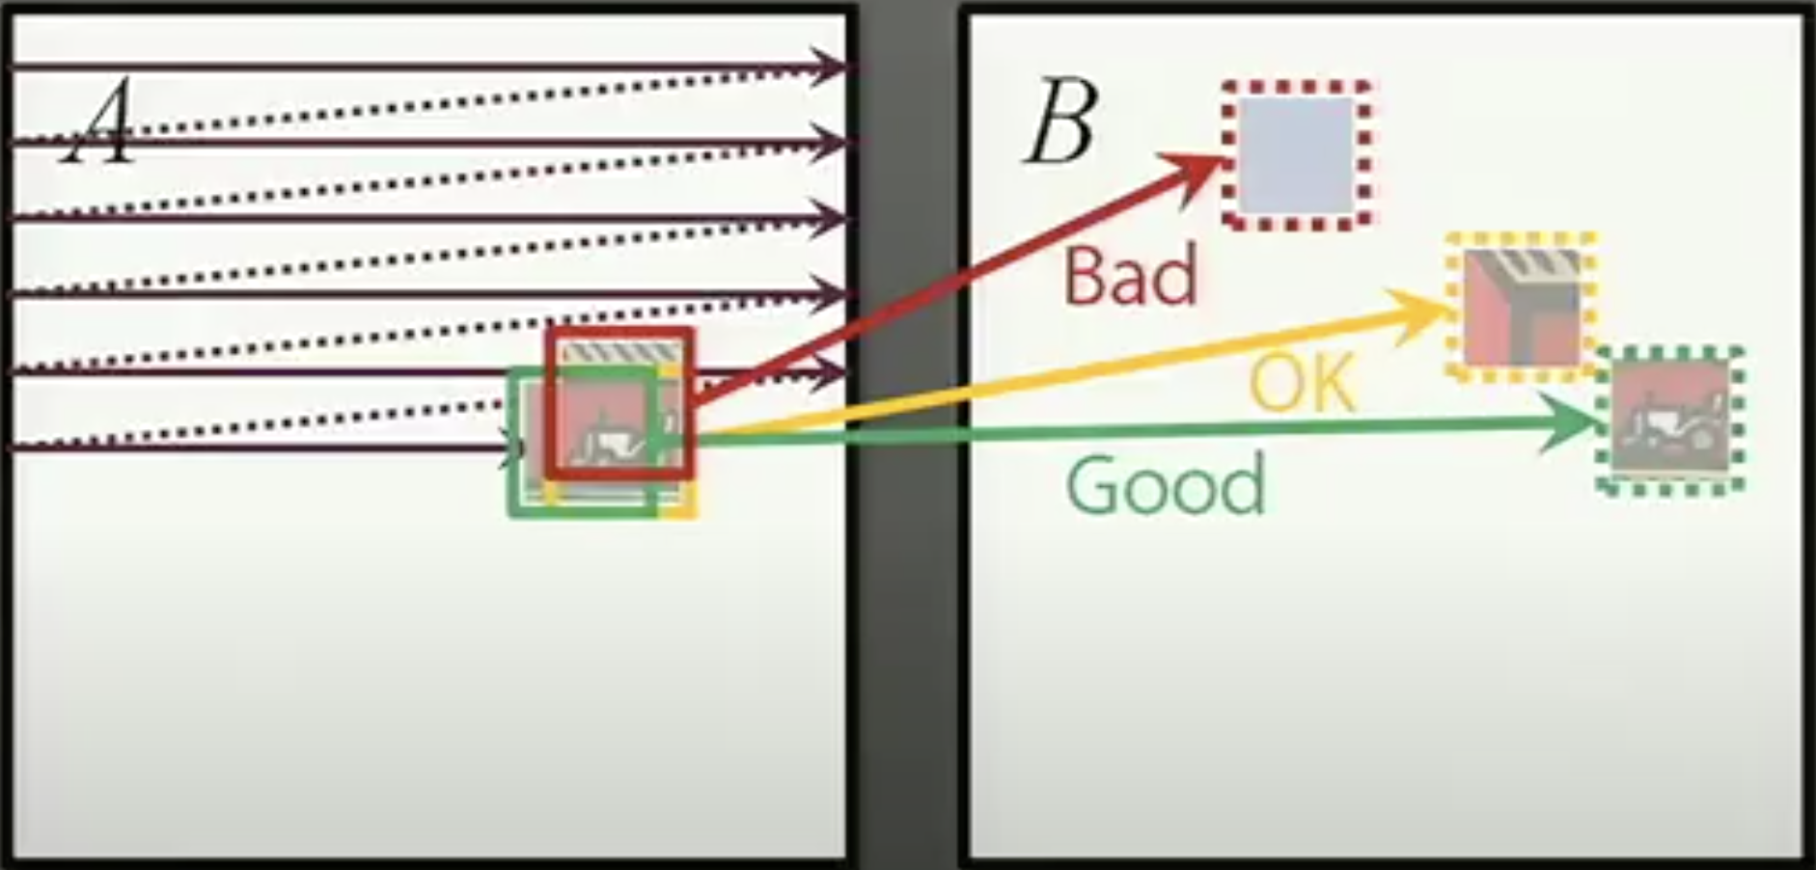
Step 2: Propagation
Try to improve offset estimate by exploiting spatial coherence with left and top neighbor (or right, bottom)
$f\left(x,y\right)={argmin}_{d}(f\left(x,y\right), f\left(x−1,y\right),f\left(x, y−1\right))$
C. Barnes, et. al. “PatchMatch: A randomized correspondence algorithm for structural image editing”. SIGGRAPH 2009
Notes:
key insights: some good patch matches can be found via random sampling, and that natural coherence in the imagery allows us to propagate such matches quickly to surrounding areas.

Slide 46
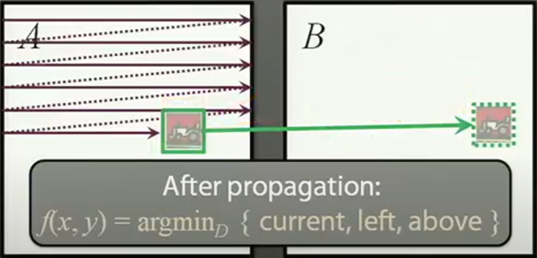
Step 2: Propagation
Try to improve offset estimate by exploiting spatial coherence with left and top neighbor (or right, bottom)
$f\left(x,y\right)={argmin}_{d}(f\left(x,y\right), f\left(x−1,y\right),f\left(x, y−1\right))$
C. Barnes, et. al. “PatchMatch: A randomized correspondence algorithm for structural image editing”. SIGGRAPH 2009
Notes:
key insights: some good patch matches can be found via random sampling, and that natural coherence in the imagery allows us to propagate such matches quickly to surrounding areas.

Slide 47
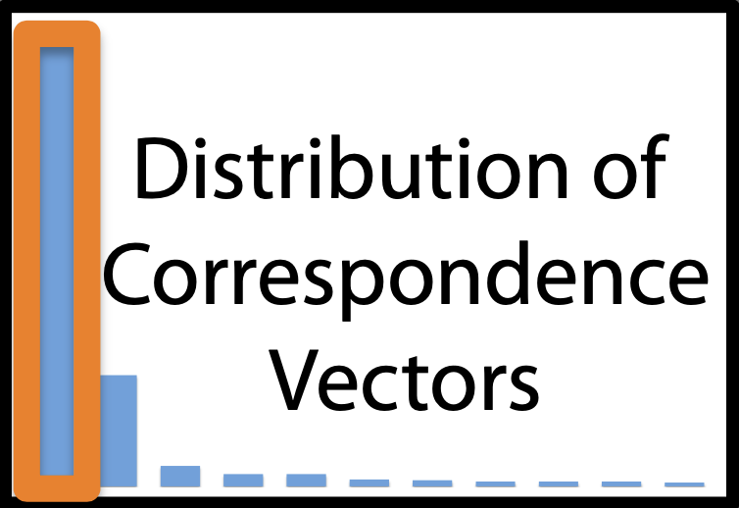
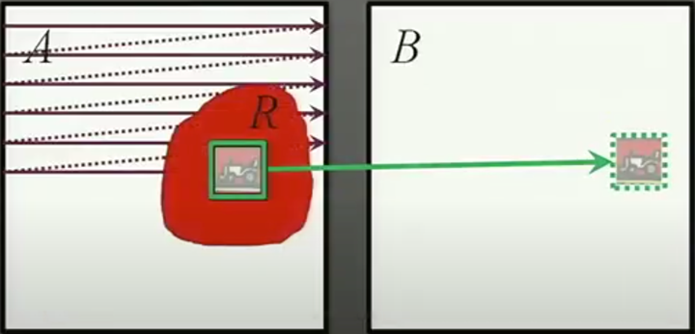
Step 2: Propagation
Try to improve offset estimate by exploiting spatial coherence with left and top neighbor (or right, bottom)
$f\left(x,y\right)={argmin}_{d}(f\left(x,y\right), f\left(x−1,y\right),f\left(x, y−1\right))$
C. Barnes, et. al. “PatchMatch: A randomized correspondence algorithm for structural image editing”. SIGGRAPH 2009
Notes:
key insights: some good patch matches can be found via random sampling, and that natural coherence in the imagery allows us to propagate such matches quickly to surrounding areas.

Slide 48
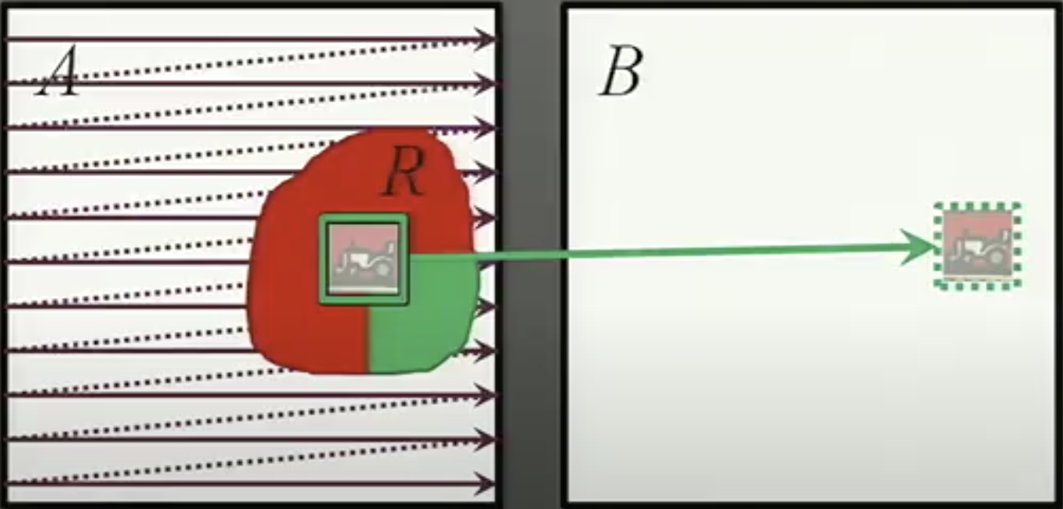
Step 2: Propagation
Try to improve offset estimate by exploiting spatial coherence with left and top neighbor (or right, bottom)
$f\left(x,y\right)={argmin}_{d}(f\left(x,y\right), f\left(x−1,y\right),f\left(x, y−1\right))$
C. Barnes, et. al. “PatchMatch: A randomized correspondence algorithm for structural image editing”. SIGGRAPH 2009
Notes:
key insights: some good patch matches can be found via random sampling, and that natural coherence in the imagery allows us to propagate such matches quickly to surrounding areas.

Slide 49
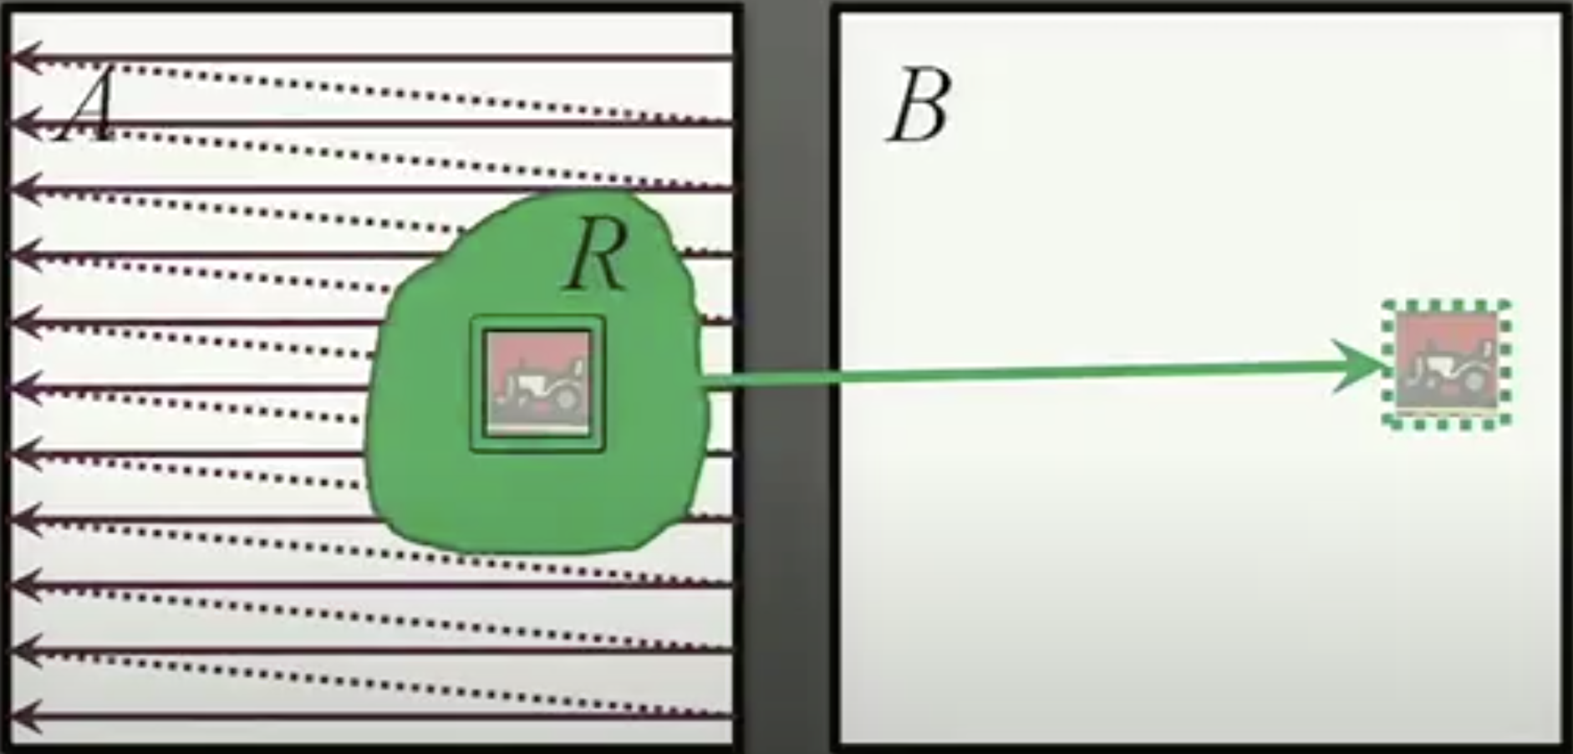
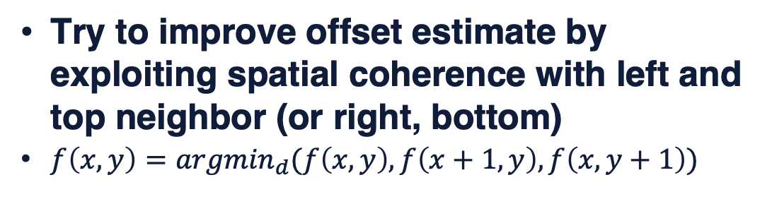
Step 2: Propagation
Try to improve offset estimate by exploiting spatial coherence with left and top neighbor (or right, bottom)
$f\left(x,y\right)={argmin}_{d}(f\left(x,y\right), f\left(x+1,y\right),f\left(x, y+1\right))$
C. Barnes, et. al. “PatchMatch: A randomized correspondence algorithm for structural image editing”. SIGGRAPH 2009
Notes:
key insights: some good patch matches can be found via random sampling, and that natural coherence in the imagery allows us to propagate such matches quickly to surrounding areas.

Slide 50
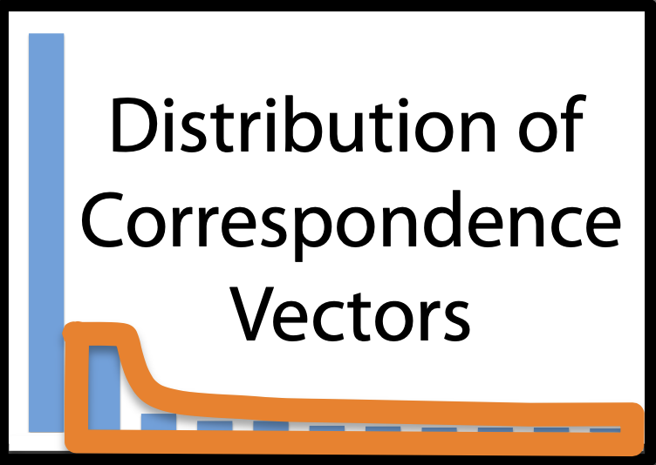
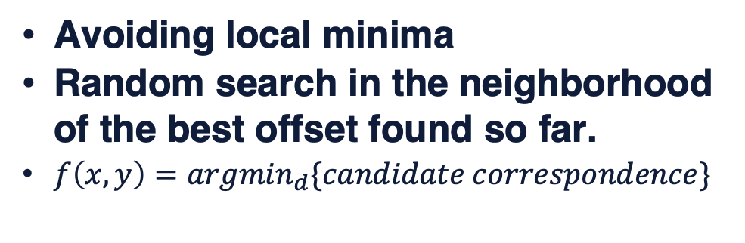
Step 3: Random Search
Avoiding local minima
Random search in the neighborhood of the best offset found so far.
$f\left(x,y\right)={argmin}_{d}\{candidate correspondence\}$
C. Barnes, et. al. “PatchMatch: A randomized correspondence algorithm for structural image editing”. SIGGRAPH 2009
Notes:
key insights: some good patch matches can be found via random sampling, and that natural coherence in the imagery allows us to propagate such matches quickly to surrounding areas.

Slide 51
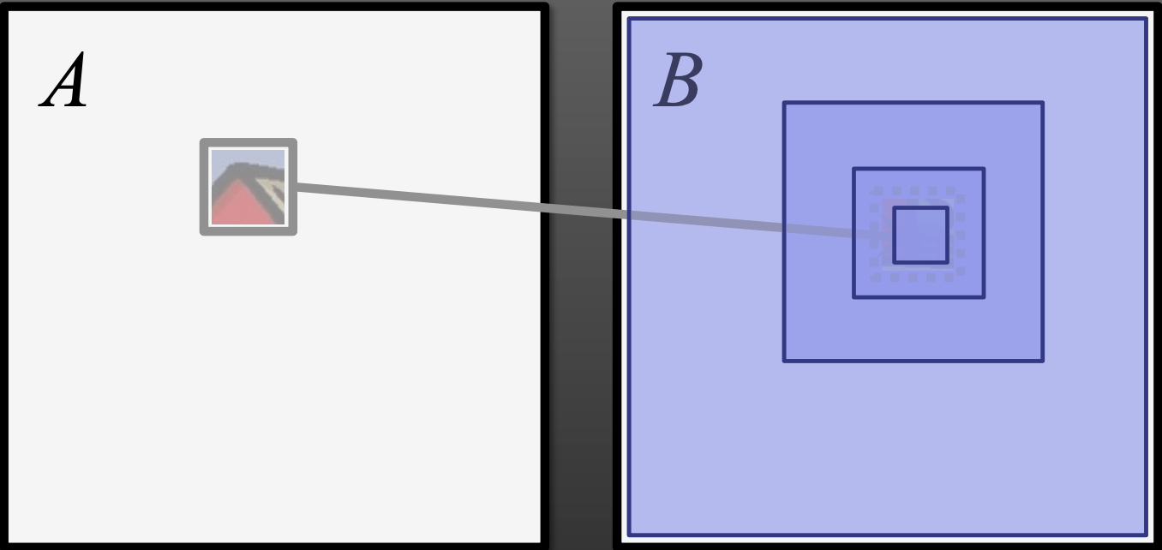
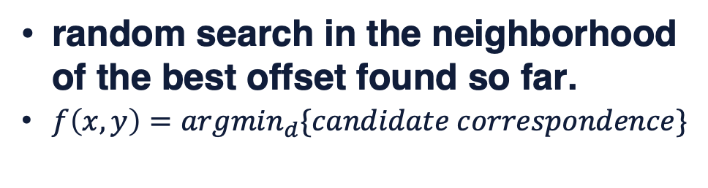
Step 3: Random Search
random search in the neighborhood of the best offset found so far.
$f\left(x,y\right)={argmin}_{d}\{candidate correspondence\}$
C. Barnes, et. al. “PatchMatch: A randomized correspondence algorithm for structural image editing”. SIGGRAPH 2009
Notes:
key insights: some good patch matches can be found via random sampling, and that natural coherence in the imagery allows us to propagate such matches quickly to surrounding areas.

Slide 52
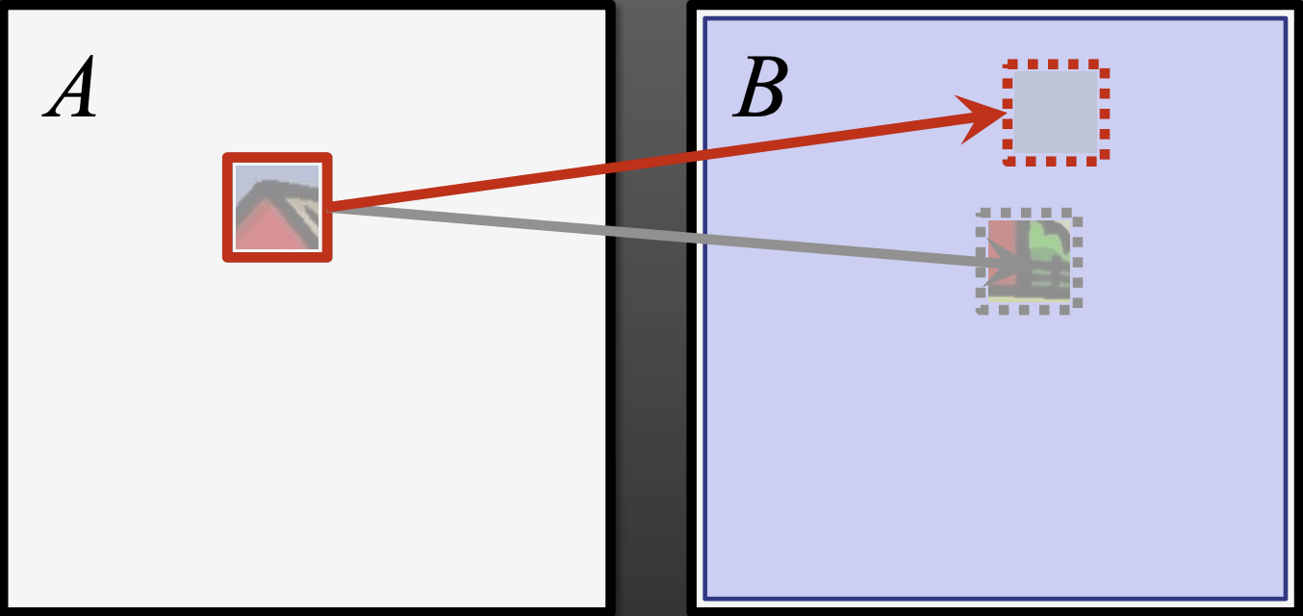


Step 3: Random Search
random search in the neighborhood of the best offset found so far.
$f\left(x,y\right)={argmin}_{d}\{candidate correspondence\}$
Box width: $w$
Notes:
key insights: some good patch matches can be found via random sampling, and that natural coherence in the imagery allows us to propagate such matches quickly to surrounding areas.

Slide 53
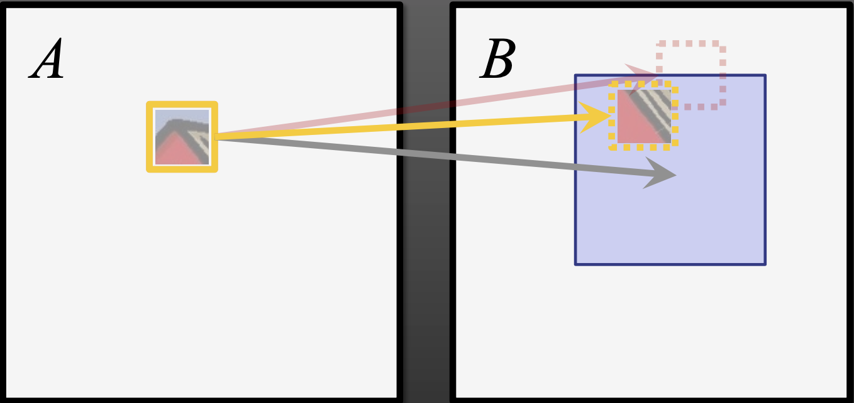

Step 3: Random Search
random search in the neighborhood of the best offset found so far.
$f\left(x,y\right)={argmin}_{d}\{candidate correspondence\}$
Box width: $αw$
Notes:
key insights: some good patch matches can be found via random sampling, and that natural coherence in the imagery allows us to propagate such matches quickly to surrounding areas.

Slide 54
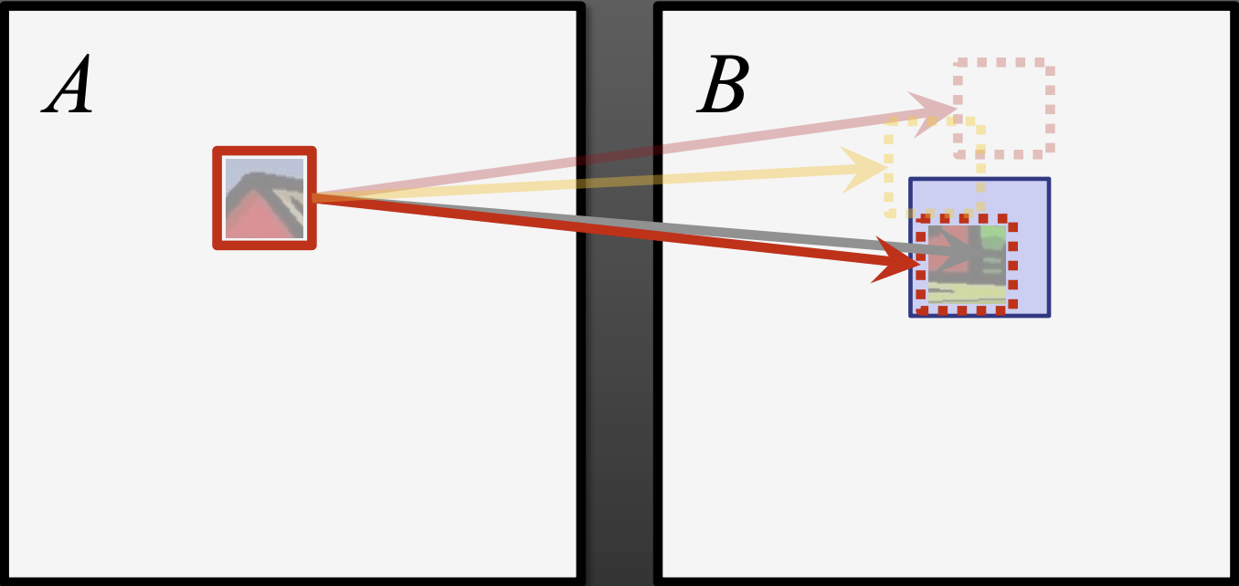
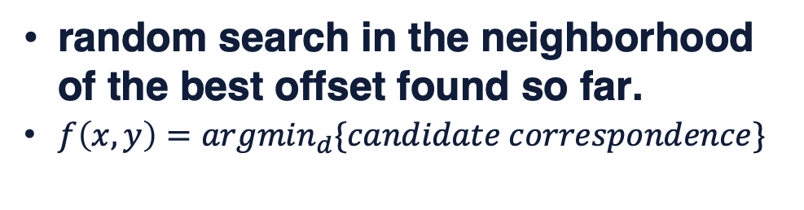

Step 3: Random Search
random search in the neighborhood of the best offset found so far.
$f\left(x,y\right)={argmin}_{d}\{candidate correspondence\}$
Box width: $α^{2}w$
Notes:
key insights: some good patch matches can be found via random sampling, and that natural coherence in the imagery allows us to propagate such matches quickly to surrounding areas.

Slide 55
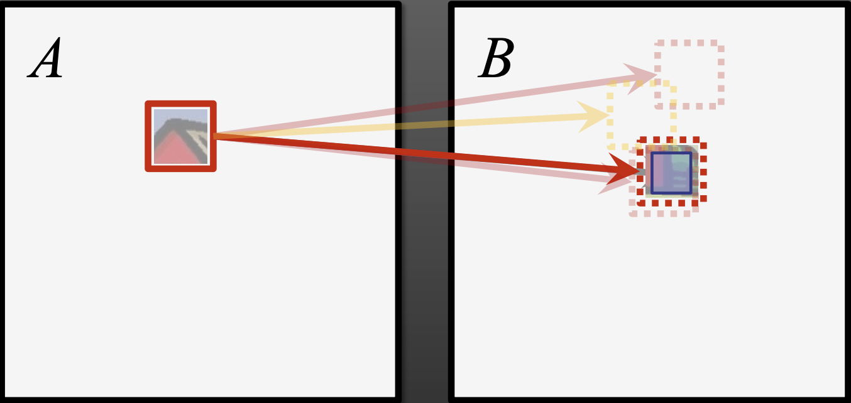
Step 3: Random Search
random search in the neighborhood of the best offset found so far.
$f\left(x,y\right)={argmin}_{d}\{candidate correspondence\}$
Box width: 1 pixel
Notes:
key insights: some good patch matches can be found via random sampling, and that natural coherence in the imagery allows us to propagate such matches quickly to surrounding areas.

Slide 56


Step 3: Random Search
random search in the neighborhood of the best offset found so far.
$f\left(x,y\right)={argmin}_{d}\{candidate correspondence\}$
C. Barnes, et. al. “PatchMatch: A randomized correspondence algorithm for structural image editing”. SIGGRAPH 2009
Notes:
key insights: some good patch matches can be found via random sampling, and that natural coherence in the imagery allows us to propagate such matches quickly to surrounding areas.

Slide 57
Summary
PatchMatch:
Step 1: Initialization
Step 2: Propagation
Step 3: Random Search
Repeat until converged
Notes:
key insights: some good patch matches can be found via random sampling, and that natural coherence in the imagery allows us to propagate such matches quickly to surrounding areas.
Although different criteria for halting may be used depending on the application, in practice we have found it works well to iterate a fixed number of times.

Slide 58
Summary
PatchMatch:
key insights:
some good patch matches can be found via random sampling.
natural coherence in the imagery allows us to propagate such matches quickly to surrounding areas.
Step 1: Initialization
Step 2: Propagation
Step 3: Random Search
Repeat until converged
Notes:
key insights: some good patch matches can be found via random sampling, and that natural coherence in the imagery allows us to propagate such matches quickly to surrounding areas.
Although different criteria for halting may be used depending on the application, in practice we have found it works well to iterate a fixed number of times.

Slide 59

Experiment: Reconstruct A using patches from B
Credit: Barnes

Slide 60
Experiment: Reconstruct A using patches from B
10-100x faster than kd-tree!
Credit: Barnes

Slide 61

Why does it work?
Assume source and target images have equal size (M pixels) and that random initialization is used.
The odds of any one location being assigned the best offset: 1 / M
But for M pixels:
The odds of at least one offset being correctly assigned are quite good:
$$1 − {(1−\frac{1}{M})}^{M}$$
E.g. M=10e5, this is (1– 0.367)
If top C nearest neighbors are enough, the odds will be $1 − {(1−\frac{C}{M})}^{M}$
C. Barnes, et. al. “Patchmatch: A randomized correspondence algorithm for structural image editing”. SIGGRAPH 2009

Slide 62
PatchMatch Stereo

Slide 63

PatchMatch Stereo
Notes:
view-dependent domain is obtained by computing the domain Ω as the projection of a 3D local patch centered around the 3D point p.

Slide 64

PatchMatch Stereo
Extend to find an approximate nearest neighbor according to a plane.
Offset -> depth
M. Bleyer, et. al. “Patchmatch stereo - stereo matching with slanted support windows”, BMVC 2011
Notes:
因此通过patchmatch计算depth的时候，我们定义一个3D上的Patch，这个patch和reference view平行，
然后把求解每个pixel和对应点的offset的问题转换回求解depth的问题，就是把patchmatch随机猜depth换成随机猜depth，在计算相似度的时候通过这个平面通过homograph warping warp过去。
computes a 3D plane at each pixel onto which the support region is projected.

Slide 65

PatchMatch Stereo
Step 1: Initialization
Step 2: Propagation
Step 3: Random Search
Repeat until converged
M. Bleyer, et. al. “Patchmatch stereo - stereo matching with slanted support windows”, BMVC 2011

Slide 66

PatchMatch Stereo
M. Bleyer, et. al. “Patchmatch stereo - stereo matching with slanted support windows”, BMVC 2011

Slide 67

PatchMatch Stereo
M. Bleyer, et. al. “Patchmatch stereo - stereo matching with slanted support windows”, BMVC 2011

Slide 68



PatchMatch Stereo
M. Bleyer, et. al. “Patchmatch stereo - stereo matching with slanted support windows”, BMVC 2011

Slide 69

PatchMatch Stereo
For Each Pixel
Assign Random Depth and Normal
For N Iterations
For Each Pixel
Propagate Depth and Normal From Neighbor
Sample New Random Depth and Normal
Update Depth
M. Bleyer, et. al. “Patchmatch stereo - stereo matching with slanted support windows”, BMVC 2011

Slide 70
PatchMatch Stereo
For Each Pixel
Assign Random Depth and Normal
For N Iterations
For Each Pixel
Propagate Depth and Normal From Neighbor
Sample New Random Depth and Normal
Update Depth
M. Bleyer, et. al. “Patchmatch stereo - stereo matching with slanted support windows”, BMVC 2011

Slide 71
PatchMatch Stereo
For Each Pixel
Assign Random Depth and Normal
For N Iterations
For Each Pixel
Propagate Depth and Normal From Neighbor
Sample New Random Depth and Normal
Update Depth
J. L. Schönberger, et. al. “Pixelwise View Selection for Unstructured Multi-View Stereo”, ECCV 2016
Notes:
Since depth θl and normal nl define a local planar
surface in 3D, we propagate the depth θprp of the intersection of the ray of the l−1
current pixel xl with the local surface of the previous pixel (θl−1,nl−1). This exploits first-order smoothness of the surface (cf. [22]) and thereby drastically speeds up the optimization since correct depths propagate more quickly along the surface.

Slide 72
Summary
Problem Definition:
Finding a “good” slanted support plane at each pixel.
The difference with vanilla PatchMatch
(offset) -> (depth, normal)

Slide 73
View Selection

Slide 74
Step 1: Source view selection
Step 2: Depth-map computation
Step 3: Depth-map merging
Key steps:
1.How to chose source images
2.How to compute depth map

Slide 75

View Selection
How to robustly integrate photo-consistency measurements from multiple views?
Credit: E. Dunn

Slide 76

View Selection
Coarse visibility estimation via pose clustering
Credit: Schonberger
Y. Furukawa. “Towards Internet-scale Multi-view Stereo”, CVPR 2010
Notes:
It proposed to use the full SfM model to drive view clustering by using the number of shared matches between any two views as an indication of the overlap between the two views.

Slide 77
View Selection
Coarse visibility estimation via pose clustering
• Camera Proximity • Shared Sparse Features
Credit: Schonberger
Y. Furukawa. “Towards Internet-scale Multi-view Stereo”, CVPR 2010
Notes:
It proposed to use the full SfM model to drive view clustering by using the number of shared matches between any two views as an indication of the overlap between the two views.

Slide 78
View Selection
Fine-scale visibility estimation
Good candidate source image ?

Slide 79
View Selection
Fine-scale visibility estimation
Good candidate source image ?
Global
-> a similar viewing direction as the target image
-> a suitable baseline neither too short to degenerate the reconstruction accuracy nor too long to have less common coverage of the scene.
Shen. “Accurate Multiple View 3D Reconstruction Using Patch Based Stereo for Large-Scale Scenes”, TIP 2013

Slide 80

View Selection
Fine-scale visibility estimation
Good candidate source image ?
Global
-> a similar viewing direction as the target image
-> a suitable baseline neither too short to degenerate the reconstruction accuracy nor too long to have less common coverage of the scene.
$5° < θ<60°$
$0.05d≤B ≤2d$
Shen. “Accurate Multiple View 3D Reconstruction Using Patch Based Stereo for Large-Scale Scenes”, TIP 2013

Slide 81


Pixel-Level View Selection
Reference
Source
Credit: E. Dunn

Slide 82


Pixel-Level View Selection
Reference
Source
Credit: E. Dunn

Slide 83

Pixel-Level View Selection
Reference
Source
Credit: E. Dunn

Slide 84

Image Selection vs Depth Estimation
visibility requires scene structure and scene structure requires visibility
This is a chicken-and-egg problem
Credit: S. Shen

Slide 85

Joint Pixel-Level View Selection and Depthmap Estimation
Maximum likelihood estimation (MLE):
Likelihood function $P(X, Z, θ, N)$:
Images:
$X=\left\{X^{ref}, X^{src}\right\}, X^{src}=\{X^{m}|m=1…M\}$
Depth:
$θ=\{θ_{l}|l=1…L\}$
Normal:
$N=\{n_{l}|l=1…L\}$
Occlusion indicators:
$Z=\left\{Z_{l}^{m} | l=1…L, m=1…M\right\}, Z_{l}^{m} ∈\{0, 1\}$
E. Zheng, et. al. “Patchmatch based joint view selection and depthmap estimation”, CVPR 2014
J. L. Schönberger, et. al. “Pixelwise View Selection for Unstructured Multi-View Stereo”, ECCV 2016
Notes:
Finding the optimal selection Z and depth θ given all the images X equates to computing the maximum of the posterior probability (MAP) P (Z, θ|X).

Slide 86

Joint Pixel-Level View Selection and Depthmap Estimation
Maximum likelihood estimation (MLE):
Likelihood function $P(X, Z, θ, N)$:
Images:
$X=\left\{X^{ref}, X^{src}\right\}, X^{src}=\{X^{m}|m=1…M\}$
Depth:
$θ=\{θ_{l}|l=1…L\}$
Normal:
$N=\{n_{l}|l=1…L\}$
Occlusion indicators:
$Z=\left\{Z_{l}^{m} | l=1…L, m=1…M\right\}, Z_{l}^{m} ∈\{0, 1\}$
E. Zheng, et. al. “Patchmatch based joint view selection and depthmap estimation”, CVPR 2014
J. L. Schönberger, et. al. “Pixelwise View Selection for Unstructured Multi-View Stereo”, ECCV 2016

Slide 87


Joint Pixel-Level View Selection and Depthmap Estimation
Maximum likelihood estimation (MLE):
Likelihood function $P(X, Z, θ, N)$:
Photometric prior
If $Z_{l}^{m}$ = 1,
$P\left(X_{l}^{m} | Z_{l}^{m},θ_{l}, n_{l}\right)∝ρ_{l}^{m}\left(θ_{l},n_{l}\right) (\text{color} \text{similarity})$
If $Z_{l}^{m}$ = 0,
$P\left(X_{l}^{m} | Z_{l}^{m},θ_{l}, n_{l}\right)=\text{uniform} \text{distribution}$
E. Zheng, et. al. “Patchmatch based joint view selection and depthmap estimation”, CVPR 2014
J. L. Schönberger, et. al. “Pixelwise View Selection for Unstructured Multi-View Stereo”, ECCV 2016

Slide 88


Joint Pixel-Level View Selection and Depthmap Estimation
Maximum likelihood estimation (MLE):
Likelihood function $P(X, Z, θ, N)$:
Spatial-temporary smoothness
E. Zheng, et. al. “Patchmatch based joint view selection and depthmap estimation”, CVPR 2014
J. L. Schönberger, et. al. “Pixelwise View Selection for Unstructured Multi-View Stereo”, ECCV 2016

Slide 89

Joint Pixel-Level View Selection and Depthmap Estimation
Maximum likelihood estimation (MLE):
Likelihood function $P(X, Z, θ, N)$:
geometric consistency
Forward-backward reprojection error
E. Zheng, et. al. “Patchmatch based joint view selection and depthmap estimation”, CVPR 2014
J. L. Schönberger, et. al. “Pixelwise View Selection for Unstructured Multi-View Stereo”, ECCV 2016

Slide 90



Joint Pixel-Level View Selection and Depthmap Estimation
Joint likelihood Estimation:
E. Zheng, et. al. “Patchmatch based joint view selection and depthmap estimation”, CVPR 2014
J. L. Schönberger, et. al. “Pixelwise View Selection for Unstructured Multi-View Stereo”, ECCV 2016

Slide 91

Robustness of Pixel-Level Selection
Pixel-level
Baseline
E. Zheng, et. al. “Patchmatch based joint view selection and depthmap estimation”, CVPR 2014

Slide 92


Robustness of Pixel-Level Selection
E. Zheng, et. al. “Patchmatch based joint view selection and depthmap estimation”, CVPR 2014

Slide 93
Summary
PatchMatch
A randomized algorithm for rapidly finding correspondences between image patches
Step
1: Initialization
2: Propagation
3: Random Search
PatchMatch Stereo
Finding a “good” slanted support plane at each pixel.
Difference from vanilla PatchMatch
(offset) -> (depth, normal)
View Selection
Coarse visibility estimation
Fine-scale visibility estimation
Joint Pixel-Level View Selection and Depthmap Estimation
Pixel-Level occlusion indicator
chicken-and-egg -> Generalized Expectation maximization

Slide 94




Slide 95
Thanks

Slide 96



Slide 97

PatchMatch based MVS
Multi-view stereo and checkerboard propagation
S. Galliani, et. al. “Massively Parallel Multiview Stereopsis by Surface Normal Diffusion”, ICCV 2015
Notes:
key insights: some good patch matches can be found via random sampling, and that natural coherence in the imagery allows us to propagate such matches quickly to surrounding areas.

Slide 98

PatchMatch based MVS
Multi-view stereo and structure priors
A. Romanoni, et. al. “TAPA-MVS: Textureless-Aware PatchMatch Multi-View Stereo”, ICCV 2019
Q. Xu, et. al. “Planar Prior Assisted PatchMatch Multi-View Stereo”, AAAI 2020
Notes:
key insights: some good patch matches can be found via random sampling, and that natural coherence in the imagery allows us to propagate such matches quickly to surrounding areas.

Slide 99
Depth-map Merging Based Approaches
Plane sweeping
Patch match
R. Collins, “A space-sweep approach to true multi-image matching”, CVPR 1996
D.Gallup, et, al. “Real-time Plane-sweeping Stereo with Multiple Sweeping Directions”, CVPR 2017
M. Bleyer, et. al. “Patchmatch stereo - stereo matching with slanted support windows”, BMVC 2011

Slide 100

Depth-map Merging Based Approaches
Plane sweeping
R. Collins, “A space-sweep approach to true multi-image matching”, CVPR 1996
D.Gallup, et, al. “Real-time Plane-sweeping Stereo with Multiple Sweeping Directions”, CVPR 2017
Notes:
In general, these 3d representations can be divided into two families– the rasterized form as regular grids, and the geometric form, which lacks canonical and regular structures.

Slide 101

Depth-map Merging Based Approaches
Plane sweeping
Yao et al., “MVSNet: Depth Inference for Unstructured Multi-view Stereo”, ECCV 2018
Huang et al., “DeepMVS: Learning Multi-view Stereopsis”, CVPR 2018
Yao et al, ” Recurrent MVSNet for High-resolution Multi-view Stereo Depth Inference ”, CVPR 2019
Notes:
In general, these 3d representations can be divided into two families– the rasterized form as regular grids, and the geometric form, which lacks canonical and regular structures.

Slide 102


Depth-map Merging Based Approaches
Plane sweeping
Yao et al., “MVSNet: Depth Inference for Unstructured Multi-view Stereo”, ECCV 2018
Notes:
In general, these 3d representations can be divided into two families– the rasterized form as regular grids, and the geometric form, which lacks canonical and regular structures.

Slide 103
Depth-map Merging Based Approaches
Plane sweeping
Pros:
Much more efficient
Perform very well in completeness
Cons:
High memory comsumption
Yao et al., “MVSNet: Depth Inference for Unstructured Multi-view Stereo”, ECCV 2018
Huang et al., “DeepMVS: Learning Multi-view Stereopsis”, CVPR 2018
Yao et al, ” Recurrent MVSNet for High-resolution Multi-view Stereo Depth Inference ”, CVPR 2019
Notes:
In general, these 3d representations can be divided into two families– the rasterized form as regular grids, and the geometric form, which lacks canonical and regular structures.

Slide 104
Depth-map Merging Based Approaches
Plane sweeping
Yao et al., “MVSNet: Depth Inference for Unstructured Multi-view Stereo”, ECCV 2018
Huang et al., “DeepMVS: Learning Multi-view Stereopsis”, CVPR 2018
Yao et al, ” Recurrent MVSNet for High-resolution Multi-view Stereo Depth Inference ”, CVPR 2019
Notes:
In general, these 3d representations can be divided into two families– the rasterized form as regular grids, and the geometric form, which lacks canonical and regular structures.

Slide 105
Depth-map Merging Based Approaches
Pros:
适用于大场景海量图像(并行计算深度图)
得到的点云数量多(冗余)
目前的开源和商用软件基本都采用这类方法
Cons:
很大程度上依赖于邻域图像组的选择

Slide 106
Topics
Introduction
Related Work
Depth-map Merging Based Approaches
Volumetric Based Approaches
Feature Point Growing Based Approaches
Multi-view Stereo and Structure Priors
Limitations and Future Directions
Notes:
There are many factors that differentiate MVS algorithms, such as the photo-consistency function, scene representation, visibility computation, and initialization requirements. Therefore, it is not an easy task to come up with a single classification. In this article we use the output scene representation as an axis of taxonomy, because it often determines the range of possible applications.

Slide 107

Task: Reconstruction
[image: oswald]
Covered methods: SurfaceNet, LSM, GC-Net, MVSNet,
R-MVSNet, PointMVSNet, BA-Net

Slide 108

Surface Reconstruction as Voxel Occupancy Prediction
project along viewing rays to build colored voxel cubes.
Ji et al., “SurfaceNet: An End-to-End 3D Neural Network for Multiview Stereopsis”, ICCV 2017

Slide 109


Predict the surface confidence for each voxel:
binarization as post-processing
Ji et al., “SurfaceNet: An End-to-End 3D Neural Network for Multiview Stereopsis”, ICCV 2017

Slide 110
Limitations:
Pre-computed voxel cubes can only take RGB colors at coarse resolution
Voxel binarization introduces quantization errors.

Slide 111

Learning-Based Stereopsis
End-to-end learning of deep features for each image pixel
Unproject image features into 3D grids
Kar et al., “Learning a Multi-View Stereo Machine”, NeurIPS 2017

Slide 112

Still very coarse resolution (32x32x32) due to volumetric representation.
Kar et al., “Learning a Multi-View Stereo Machine”, NeurIPS 2017

Slide 113


View-aligned cost-volume construction
Differentiable soft-argmin to achieve sub-pixel accuracy
Kendall et al., “End-to-End Learning of Geometry and Context for Deep Stereo Regression”, ICCV 2017

Slide 114

Idea 1: Slide-by-Slide Processing of Cost Volume by Recurrent Neural Network
The cost volume is sequentially regularized along the depth direction.
Yao et al., “MVSNet: Depth Inference for Unstructured Multi-view Stereo”, ECCV 2018
Yao et al., “Recurrent MVSNet for High-resolution Multi-view Stereo Depth Inference”, CVPR 2019

Slide 115

Idea 2: Point-based MVS
Point-based representation for computational efficiency.
Iteratively update the location of points and spawn more points.
More flexible and accurate.
Chen et al., “Point-Based Multi-View Stereo Network”, ICCV 2019

Slide 116


hypothesized point generation along camera direction:
PointFlow: iteratively pull all the points to the right position.
Chen et al., “Point-Based Multi-View Stereo Network”, ICCV 2019

Slide 117


Iterative refinement:
Results on DTU benchmark
Chen et al., “Point-Based Multi-View Stereo Network”, ICCV 2019

